Slide 1
Conceptual Modelling
IN705 Databases 3 - 2019
Notes:
Based on Churcher, chapters 3-6

Slide 2
Useful References
Churcher, Clare (2007) ,Beginning Database Design, From Novice to Professional. Apress.
Simsion, G.C. & Witt, G.C. (2005), Data Modelling Essentials. Elsevier.
Notes:
Some of the examples we will look at today come from these two books.
They are both excellent, in-depth treatments of the modelling process.

Slide 3
Required Reading
Churcher
Chapters 3 & 4
http://proquestcombo.safaribooksonline.com/book/databases/database-design/9781430242093

Slide 4
Purpose
To develop a formal representation of the problem space our database represents.
This representation is independent of any logical model, language or DBMS.
Notes:
For example, we are going to be translating it into a relational schema (i.e. Tables) because we are using a relational DBMS this term (SQL Server).
We could, however, choose to translate it into XML for more convenient delivery over the web. Or into an object-oriented system, because we like those.

Slide 5
Basically…
Understand the problem
Identify the things (entities), their attributes, and the relationships between them
Draw the diagram
Notes:
Right, you’ve done this before
In fact….

Slide 6
But We Did This in DB2....
We do it again because
It is difficult
Is it not automatic or mechanical
It is critically important to the quality of the final product
We will look at some of the more advanced issues in the process.
No Wizard
No logical steps
Notes:
I know you did, but we have to do it again.
And, if you go into database design, again and again and again
Of all the topics we will cover this term, this is the hardest one. Because it is the one that takes creativity
There is no Wizard to click through like in DBA, no mechanical set of steps to follow like in logical design.
This one is an art, and it takes practice – a lot of it.
Also, if you screw up the model, it doesn’t matter how many subqueries deep you can go, you won’t be able to get the knowledge out.
Also, for the code monkeys, the process you go through to build a data model is very similar to the process you go through to build a class architecture. Practicing either will help you do the other better.
We assume that you know the basics, and we will this time be able to look at some of the more subtle and complex aspects of the process

Slide 7
What Can Go Wrong
Data integrity can be affected
Performance (speed) can be hurt
The system can be rigid
Blocked or deadlocked transactions can occur
Functional requirements can go unsatisfied
Notes:
If you build a database from a bad model:
Data Integrity
Data integrity means that all your data values are in the correct domain, all constraints are implemented, all values are correct, etc.
Not getting your constraints right is an obvious risk error, as it not normalising correctly (we’ll see what this is formally later, but informally, it’s making sure that you only store each value once, so you never have two that can get out of sync)
But even something as seemingly minor as not choosing your field names right can give you problems if, for example, you use the wrong terminology, causing data entry errors later on
Performance
A poorly constructed model can result in query problems, where you don’t have the structure you need to answer the questions the client wants to ask.
This can slow things down considerably
If it gets bad enough, it may be a matter of “impossible”, not just slow
Rigid
Rigid = not scalable, can’t handle change gracefully. If you’re really writing software that’s supposed to be useful to a long time (as opposed to just until you get your marks back) that’s not good enough

Slide 8
What Can Go Wrong
“Although you can achieve performance gains by retrofitting a database with various types of indexes and more powerful hardware, you can never completely compensate for a bad data model. “
Poolet, 2005

Slide 9
What Can Go Wrong
“I’ve personally served as an expert witness in several court trials where plaintiffs sued defendants for serious financial remuneration when custom database applications had performance and/or data accuracy problems. In every case, there was a failure to data model the business requirements. Thus, the data effectiveness suffered. … No amount of coding could overcome the resulting bad database design. So, in every case, the plaintiff won. “
Scalzo, 2009
Notes:
http://www.information-management.com/infodirect/2009_123/data_modeling_databases_management-10015423-1.html?ET=informationmgmt:e972:2178170a:&st=email

Slide 10
Remember...
For a given context, there is no “perfect” conceptual model.
“It is never possible to say that a given data model is the correct one. We can only say that it meets the requirements of a problem within a given scope, and subject to certain assumptions or approximations.”
- Churcher
Notes:
One of the reasons for, and consequences of this subjectivity is that there is no right answer
Different people will produce different models
Some aspects of reality will have to be omitted or fudged because they are not pertinent to the problem we are solving
And the appropriate model for the same data context will be different depending on what the user wants to do with their database.
Always keep this in mind: The goal is to turn data into information. Specifically, the information your client is looking for.

Slide 11
Process Overview
Requirements Elicitation
Identifying the Entities
Modelling the Attributes and Relationships
Verifying the Model
Notes:
You will note that there is no discussion here of eliminating redundancy or resolving many-to-many relationships.
These are issues in the next step of the process – logical modelling – where we will take our ERD and make it into tables
In this advanced course, we will take a formal approach to that process called “normalisation”, that will introduce rigour into our development cycle.
But we don’t worry about it here in the Conceptual Modelling stage. This is about getting an entity-relationship representation of our data universe, to the level of detail necessary to solve the client’s problem.
Note that this is only one SDLC that is used. There are others where, for example, the data model is converted into a relational schema prior to verification (which is done with the client)
However, some authors have argued, convincingly to me, that it is easier for the client to understand an ERD than to understand a bunch of normalised tables.

Slide 12
1. Requirements Elicitation
Determining
What data the model represents
How the data will be used
Usually accomplished by talking to the client
Have you ever tried talking to a user???? It’s confusing.
Notes:
If you do databases for a living, you will be building systems about all kinds of data universes, some of which you won’t know anything about.
That, of course, won’t work, so the first step is always this: find out what the thing is supposed to do
We do this, as we do any early product design, by talking to the client and, ideally, to the users
Problem is this: Have you ever tried talking to a user? It’s confusing. They find it hard to articulate what they want, they can’t understand you when you speak geek, and generally the situation is fraught and error prone if you view it as “talk to the user”
Like all software engineering flavoured things, it works better if you have an organised process, and many have been developed that can be shown to facilitate the elicitation step.
The one we are going to discuss is “use case”
This method will be helpful to you for any software dev with clients, db or not, including Project
Use cases: What might people want to do with these data?
Understand what tasks all the people who will use the system need to carry out (the Sports Team example, with “ignoring fill-ins if the database is for getting in touch with team members in the event of a cancellation” is a good one here. The issue isn’t “what might one ever do in this data universe” it is “what does this client want this database for”)
Figure out what data you will need to store in order to support those tasks.
Questions to guide:
What does the user do (that involves the data we’re working with)
What data is involved
What is the objective of the system
What data is required to satisfy the objective
What are the input use cases
What are the output use cases

Slide 13
Use Cases
Semi-formal methodology for figuring out how a system will be used
Associated notation that facilitates communication between designers and clients.
Notes:
“Use Cases” is formally a part of the UML system, but it’s really just an organised approach to figuring out how a system is going to be used

Slide 14
Use Cases
Process
Through discussion and observation, identify what tasks all the people who will use the system need to do.
Figure out what data you will need to store in order to support those tasks.
Make a clear diagram of your plan.
Present the diagram to the client for discussion.
Repeat......

Slide 15
Questions to Guide You
What does the user do?
What data are involved?
What is the objective of the system?
What data are required to satisfy the objective?
What will be input?
What will be output?
Notes:
Ask yourself these....
And 1000s more.
Learning to figure out what clients want takes practice.
You worked on this in software engineering
Your 3rd year project depends on it

Slide 16
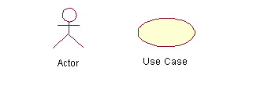
Use Case Diagrams
Diagram
Detailed written description
There are very strict rules, but don’t get bonkers about it.
Just do what’s needed to make your plan clear to your client
It’s more important to think thoroughly and completely than to get all finicky about the symbol rules.
Notes:
Remember the second step was to draw a diagram to show the user your plan
UML-style use case diagrams look like this.
There are very strict rules, but don’t get bonkers about it.
Just do what’s needed to make your plan clear to your client
It’s more important to think thoroughly and completely than to get all finicky about the symbol rules.
These are the two basic elements of a use case diagram – the person doing something (called an actor) and the thing they’re doing (called, confusingly, a “use case”)
In addition to the diagram, each Use Case has a written description that details exactly what you mean. This is a very important part of the technique. More important than the little symbols, really.

Slide 17
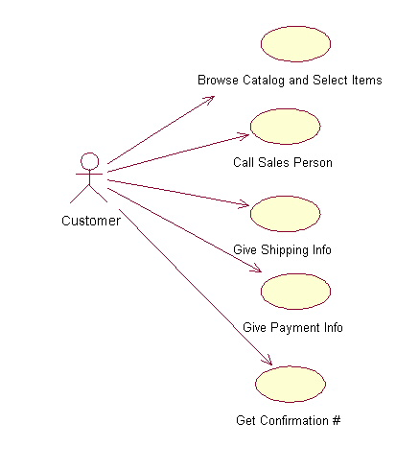
Simple Use Case Diagram
Notes:
A simple product, or a very high-level description will have a simple use case diagram.
Here we see use cases, from the shopper’s perspective, of a purchasing system

Slide 18
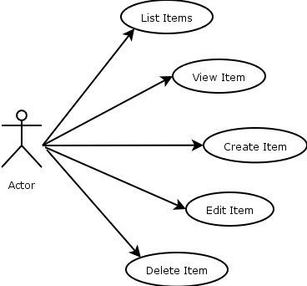
Higher Level of Detail
Notes:
Sometimes we break down into more detail.
Here a single use case might be “Manage Inventory”, but because your discussion with the client highlights the importance of the interface design for this process, you break it down into individual actions involved in managing inventory.

Slide 19
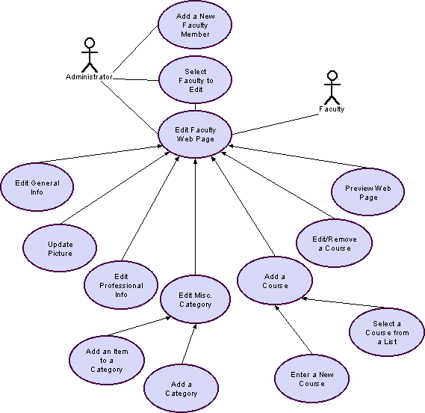
Medium Complexity Use Case Diagram
Notes:
More complex systems, or if you’re modelling at a higher level of detail will give you more complex diagrams
Here we see multiple users simultaneously for a college web site
Remember that there are detailed written descriptions that go with each use case.
These would explain, for example, what the categories are, or what professional information is involved.
They would also incorporate business rules, for example what the policy is for adding or removing a course.

Slide 20
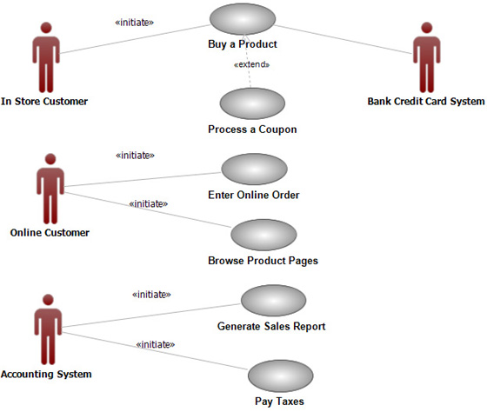
Multiple Actors
Notes:
Note that a production system will have many users (even if it has only one client)
Remember to consider them all

Slide 21
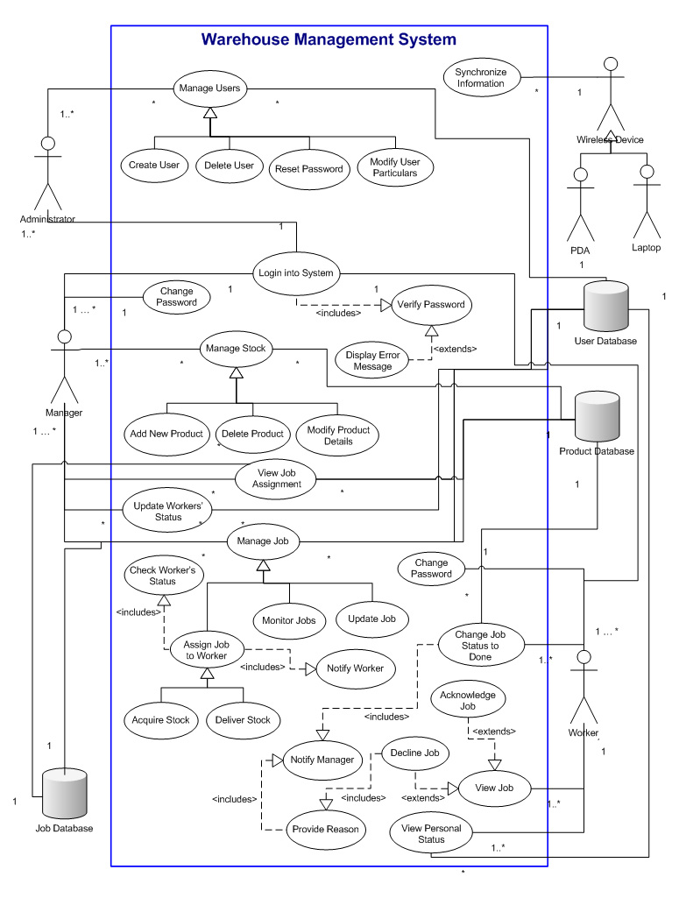
Very Complex Use Case Diagram
Notes:
Sometimes things can just get out of hand
Remember that one of the purposes of the diagram is to help the client understand your plan
This probably won’t
So generating a good use case diagram is a Goldilocks and the Three Bears problem – not too much and not too little. It has to be just right.
Sometimes you won’t realise that your diagram isn’t at the right level of detail until you discover that your client is confused (too much detail) or has a completely different notion of what they wanted (probably not enough detail along the way somewhere).
Conceptual modelling. Not easy.

Slide 22
2. Identification of Classes
After you fully understand the data universe to be represented, and the tasks to be performed, identify the things
Notes:
This usually isn’t hard to do.
Some people recommend suggesting all the nouns as entities and seeing how it goes…

Slide 23
Identification of Classes
An agricultural research lab is studying the impact of parasites on New Zealand sheep farms.
At regular intervals they visit several farms, take samples in different paddocks, and record the numbers of particular parasites they find.
The want a database that will help them to hold, analyse, interpret and understand their data.
What are the entities?
Notes:
Example:
To check, think of questions someone might ask. Can you answer them?
Farm
Parasite
Experimenter – “Is there some main effect of collector?”
Paddock – “Are all the areas of this farm equally affected?”
Visit – Why? If this isn’t an entity, we may end up recording it more than once (more about this later…..)
Region
Weather
Stock – “Does it matter what kind of critter lives in the paddock?”
….,

Slide 24
Optionality and Cardinality
Given a rough, initial data model, carefully consider the optionality and cardinality of each relationship.
This process can
Identify basic errors in the model
Generate further questions for the client to improve the accuracy and suitability of the model.
Notes:
Optionality: 0 or 1. Is it mandatory?
Cardinality: 1..n: How many can there be?

Slide 25

Optionality and Cardinality
Notes:
Remember the farm-parasite study.
Assume they have decided to record the weather conditions on each visit
This seems like a good opt/card choice: For each visit you record exactly one weather condition (e.g. rain, snow, fine, overcast…) and each weather condition may apply to 0 or more individual visits.
Any problem? Does this decision impose any assumptions on reality that might not work for us?
Yes: What if the weather is fine when they get there, but starts raining before they leave? Then they really need a 1.n relationship at the weather end.
How to decide?
In this case, we’re not so much trying to model reality truly accurately as we are trying to model the relevant aspect of reality for the client.
If most cases are stable weather, and they really don’t care about each individual sample, let it go, even though it’s not a completely accurate reflection of meteorology.

Slide 26
3. Entity, Attribute Or Relationship?
Entity = Thing
Attribute = Property/characteristic of thing
Relationship = Association between things
Notes:
You’ve learned about your problem, you’ve thought about all the things, you’ve thought about all the ways things are associated
It should now be pretty easy to draw entity boxes and put properties in them, and slap some lines in between them, right?
Maybe…

Slide 27
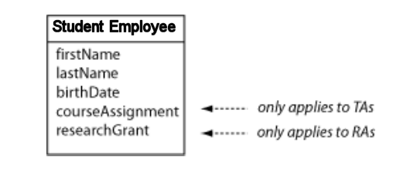
Generalisation and Specialisation
Notes:
Let’s assume we’re finally going to get some student assistants
There are teaching assistants to help in the classroom, and there are research assistants to do research grunt work, and any student can only be one or the other
If you’re a teaching assistant, we need to keep your course assignment, if you’re a research assistant, we need to keep your grant budget number.
If we have a student employee class like this, we run into all kinds of problems – wasted space, data integrity (what happens if you get a data entry error and end up with values in both? What does that mean?), complex conditionals in queries, and so on.
Because really, the situation is more accurately modelled like this….

Slide 28
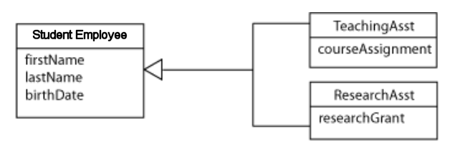
Generalisation and Specialisation
Notes:
This is specialisation
The notation is very similar to OO inheritance; the arrow denotes a parent/child or superclass/subclass relationship.
While working on your model, you may discover the need for specialisation when an entity you thought was one thing turns out to contain two distinct groups
You may also discover the need for generalisation, when what you originally thought were multiple distinct entities turn out to have some things in common…

Slide 29
Generalisation and Specialisation
Is assigned
Person
Parking Space
Name
Address
0..1
0..1
Number
Student
Paper
Is taught by
Lecturer
enrols in
Programme
Paper Code
Salary
0..n
0..n
0..n
1..1
Notes:
The problem is that we are treating Student and Lecturer as different things, and they are, when you’re talking about salary and major and so on.
But they’re not when you’re talking about parking spaces. They are really just different flavours of a more general entity, “Person”
So it’s better to model this situation with a superclass “Person” who holds the common attributes. It is person who holds the parking space, and now easily it’s 1-1.
This is generalisation.
(Note that we now need specialisation to get Student and Lecturer from Person.)

Slide 30
Generalisation and Specialisation
You are writing the database for the DCC dog registration system. Non-working dogs are $80 a year, and working dogs are $21 a year.
Since we are storing different information for the two kinds of dog, should they be represented as separate entities (i.e. subclasses)?
Notes:
How about this one?
Nope, this is just different values on the same attribute. Don’t go inheritance-crazy.

Slide 31
The Problem with Inheritance for Relational DBMS
Generalisation and specialisation are powerful modelling techniques, and are often effective in clarifying relationships between entities
Unfortunately, they are not part of the relational algebra
A workaround is required when converting from the conceptual to the logical model
Use them anyway
Notes:
There is nothing in the relational model that supports inheritance at all.
When you get to the whole tables/columns/keys things, it can’t be done, at least not directly.
There are a couple of work-around approaches, that we will cover when we look at the conversion from conceptual to logical models.
This is part of the argument in favour of OO databases, but only a weak one
In conceptual modelling you should definitely use them, even though they are a little awkward to translate into a RDBMS.
Remember the goal of conceptual modelling is to capture the data universe and communicate with the client. So use them.

Slide 32
4. Verifying the Model
Compare against your use cases
Ask the client

Slide 33
Todays Lab
For each scenario, think about:
What questions would you ask the client?
What might the use cases be?
What are the main entities?
What are their attributes?
Where are the relationships? How would you label them?
Can you assign optionality and cardinality?
Etc.
Notes:
In our next session, we will go through the process of converting a conceptual model to a logical one
We will make tables with columns, we will define keys and we will normalise (don’t worry if you don’t remember the details from DB2)
Then you will be given your modelling assignment, which you will work on during week 3.
You will be placed into groups for this assignment.
Your particular problem will be one of the set shown on the next slide.
For your homework tonight, wander around and think about these (all of them) as though you were designing a conceptual model.

Slide 34
Lab Ideas
Animal shelter Art Gallery Chess Tournaments Orchestra Dog kennel Farm management Football teams and fixtures Gaming league Help desk | Holiday cottage rental Hotel room booking system Museum Musicians in a band Pizza deliveries Vehicle details Video rentals Weddings Wildlife Park or Zoos

